Slide 1

Project 1
Jack Harvey, Svitlana nAZARcHUK , Adib Khan, Shawn Cavalieri

Slide 2
methodology
Our goal:
To specifically look at the impact of the Global Financial Crisis on Unemployment, Median Housing Prices, and birth rate.
Question we are trying to answer:
What were the general trends regarding unemployment, housing prices, and birth rate after the great recession? Can we draw any conclusions from the data?
What data did we use/how did we clean it?
We used data from the USDA ERS and the Federal Housing Finance Agency that showed the civilian labor force (CLF), unemployment rates, birth rates, and median housing prices by state from 2007 to 2018
Began with information of all states and counties (for all metrics listed above) and decided we didn’t need to use the county level data
Dropped and renamed columns for easier readability and consumption
Created functions to change data from strings to floats and define different variables, such as state unemployment and state population
Merged the cleaned datasets together so all data could be compared
What we did with the data:
We used the civilian labor force as the main group, and binned each state by it’s CLF count
The main bins for this presentation are states with over 5,000,000 CLF population and states with under 1,000,000 CLF population
Used a for loop to compare all of the data we needed at once vs. 50 different functions
Binned data based on CLF size and median house price to compare against each other

Slide 3
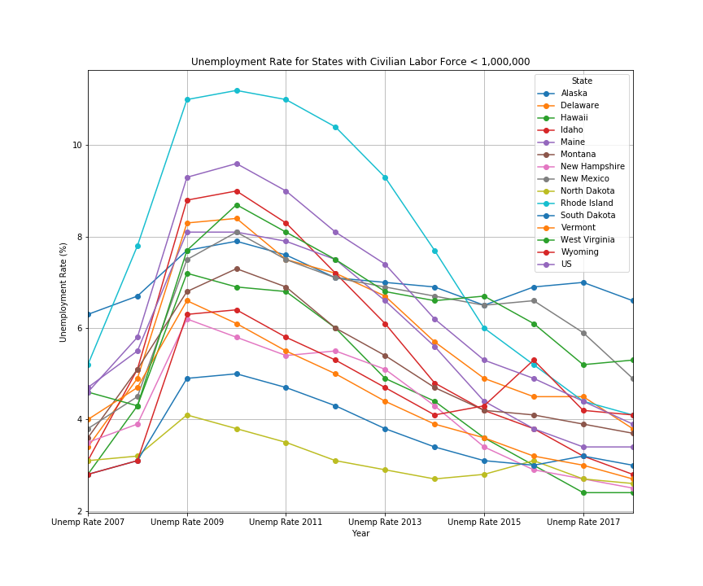
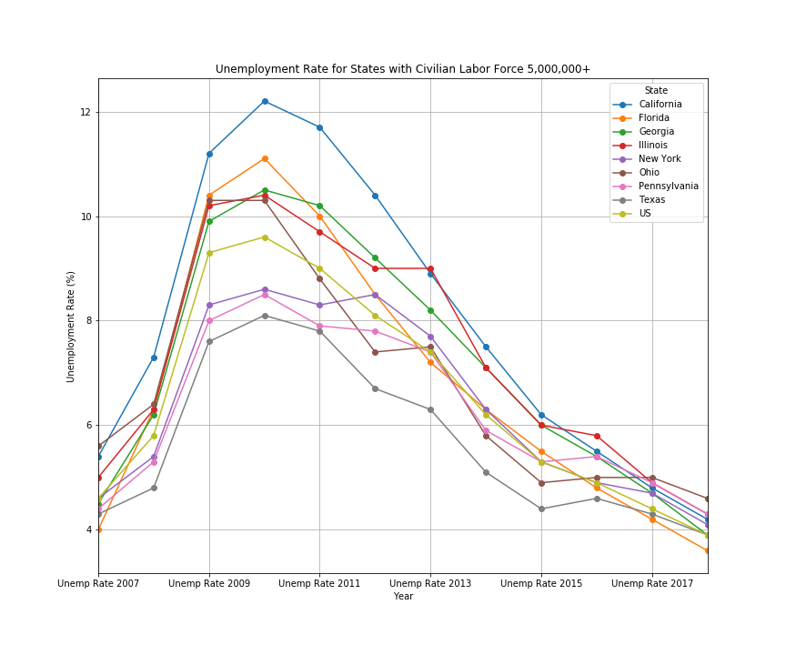
Part #1 – unemployment Rates vs. CLF
Findings
The number of CLF has no impact on the general trend of decrease in unemployment.
We can see that unemployment reaches its peak at every state in either 2009/2010. This peak remains here for every state regardless of the CLF population. Then after this peak, you can see a decreasing trend of unemployment in all states

Slide 4
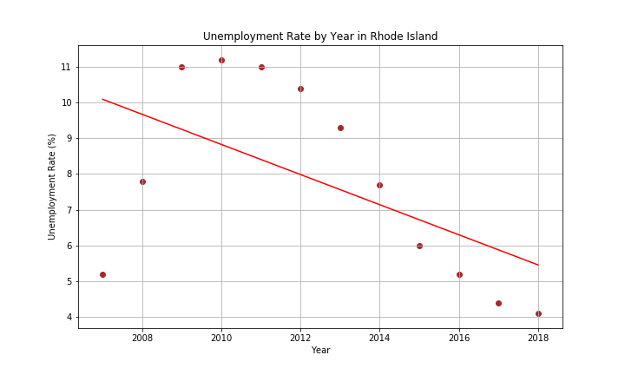
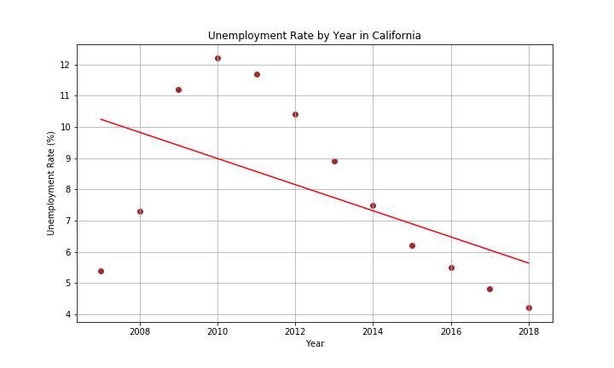
Part #1 – unemployment Rates vs. CLF Continued – Rhode Island vs. California
R-value: -0.551
R-value: -0.528
Findings
Two specific examples of large vs. small CLF show almost an identical trend and regression line for unemployment by year
We don’t believe there is any correlation between CLF and unemployment rate
The R-value, correlation coefficient, measures the strength and direction of a linear relationship between two variables on a scatterplot. These graphics tell us that the two states follow a similar linear relationships.

Slide 5
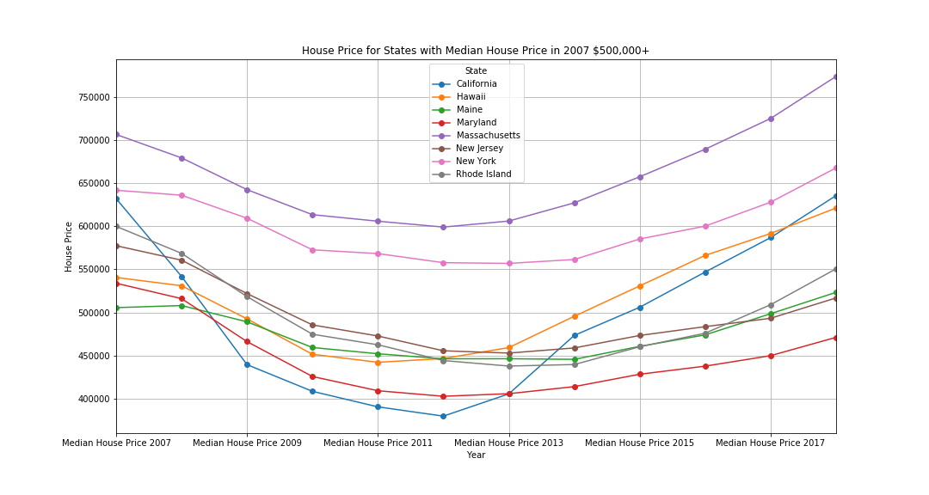
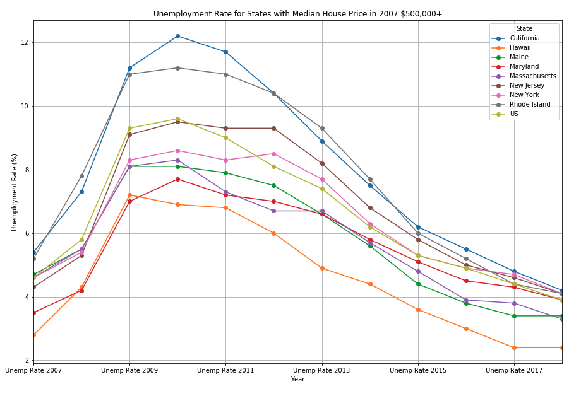
Part #2 – Median House Price – Rhode Island vs. California
Findings
Rhode Island and California are both in the highest median price bin, yet were in opposite CLF bins (under 1,000,000 vs. greater than 5,000,000)

Slide 6
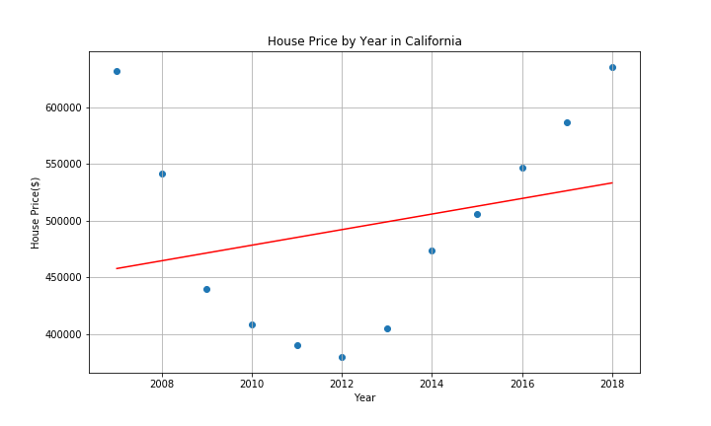
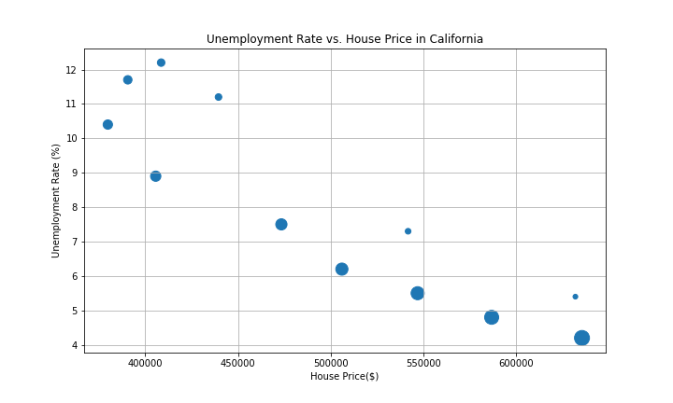
Part #3 – unemployment Rates vs. Median House Price - California
Findings
Small bullets on chart represent earlier years, get larger as time/years pass
Home Prices decreased in California as unemployment rose, and increased as unemployment decreased back to pre-recession levels
R-value: 0.265

Slide 7
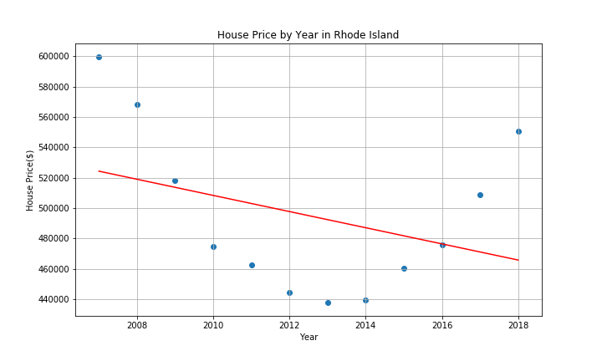
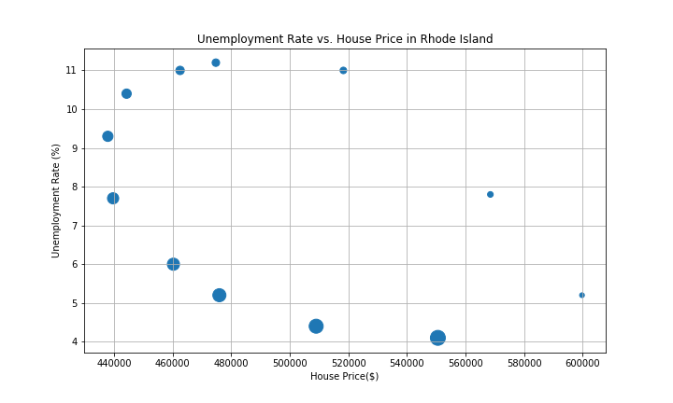
Part #3 – unemployment Rates vs. Median House Price – Rhode Island
Findings
Similar findings to California, prices still have not returned to pre-recession levels here even though unemployment rates have returned to normal
R-value: -0.354

Slide 8
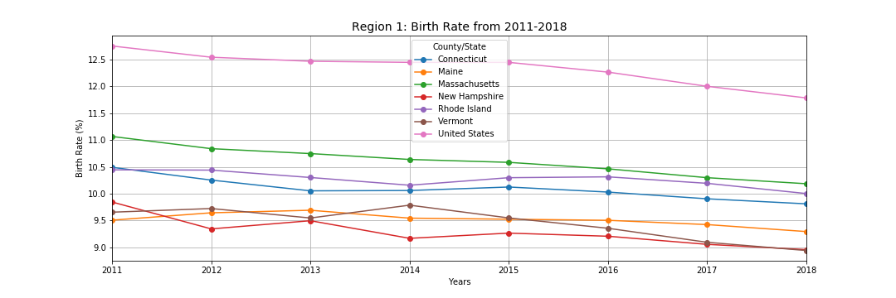
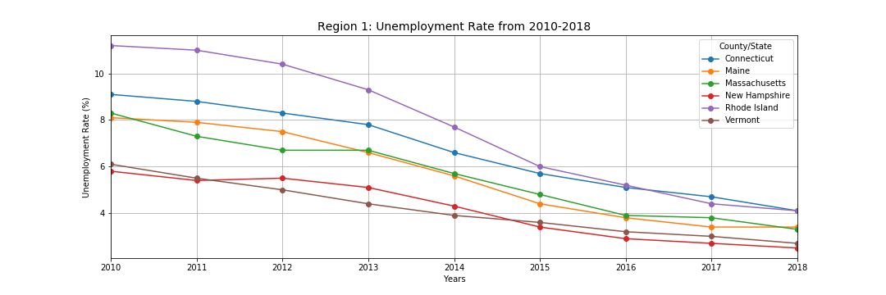
Part #4 – unemployment Rates vs. Birth Rates
Findings
Broke out birth rates into 10 regions
Graph here shows region with lowest birth rates
Expected to see birth rate increase as unemployment rates decreased, but that is not the case here

Slide 9
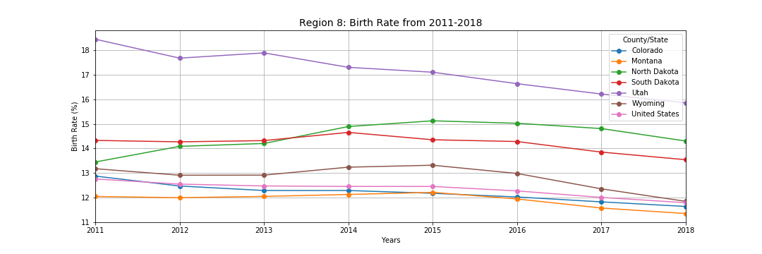
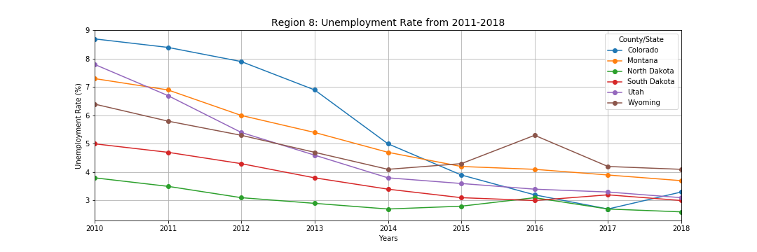
Part #4 – unemployment Rates vs. Birth Rates
Findings
Graph here shows region with highest birth rates
Again, expected to see birth rate increase as unemployment rates decreased, but that is not the case
Can conclude that birth rate and unemployment rate do not have a correlation today

Slide 10
Final Conclusions
The size of the CLF doesn’t have a strong correlation with unemployment rates as compared to other states
The CLF of a state doesn’t influence what the median housing price is in that state
See Rhode Island vs. California
Unemployment rates and median housing prices have an inverse relationship
Housing prices increase as unemployment rates decrease, and vice versa
Despite unemployment rate decreasing significantly from 2010 to 2018, birth rate went down as well. The lowest birth rate in 2018 was in New Hampshire and Vermont, and the highest was in Utah and North Dakota.

Slide 11

Thank You

